Slide 1

Notes:
.

Slide 2
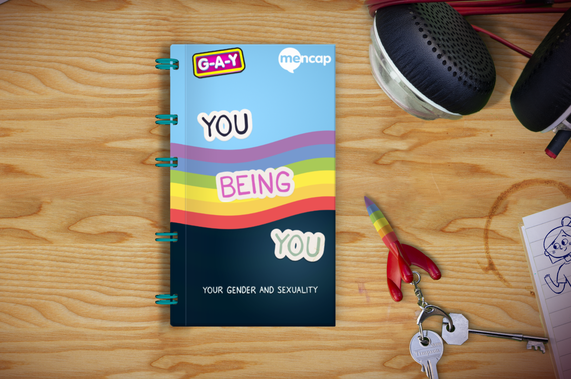
You Being You
An animation about gender identity, gender expression, sexuality and celebrating you being you!

Slide 3
How to use this presentation
Play the animation in the following slide
Use the following slides to go through the animation
Underneath each slide there are 'notes' with suggested discussion points
It might be better to split this into sections and repeating them rather than doing it all once
For more information and resources visit Mencap's website
Notes:
In addition to the glossary and our resources list, please visit these websites for more information and guidance
http://genderedintelligence.co.uk/
https://www.stonewall.org.uk/
If you are using this as part of teaching Relationships and Sex Education please ensure your other resources and sessions are LGBTQ+ inclusive and you use images and references that are inclusive throughout.
This may open up conversations about gender and sexuality at home. It could be helpful to share information and advice with families. Brook and Mencap have some advice for families and carers on talking about sexuality and relationships https://legacy.brook.org.uk/attachments/Guide_for_families_BrookMencap.pdf
You can also signpost families to Mencap's FAQ or to HealthUnlocked which is a forum for families

Slide 4
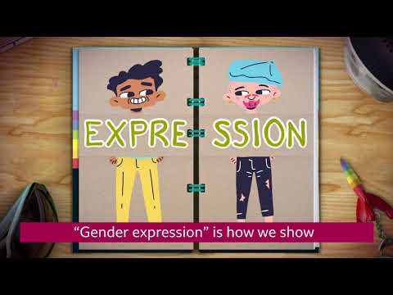
You Being You click to play video https://www.youtube.com/watch?v=9ymLgLfLQbw&feature=youtu.be
Notes:
https://www.youtube.com/watch?v=9ymLgLfLQbw&feature=youtu.be
We suggest you play the video through fully once and then go back and play sections again as you work through the discussion points.
Use Easy Read resources and other materials linked in the final slide to help guide the conversation

Slide 5
Discussion points
Notes:
The following slides contain discussion points, some activity suggestions and signpost to further information and resources

Slide 6
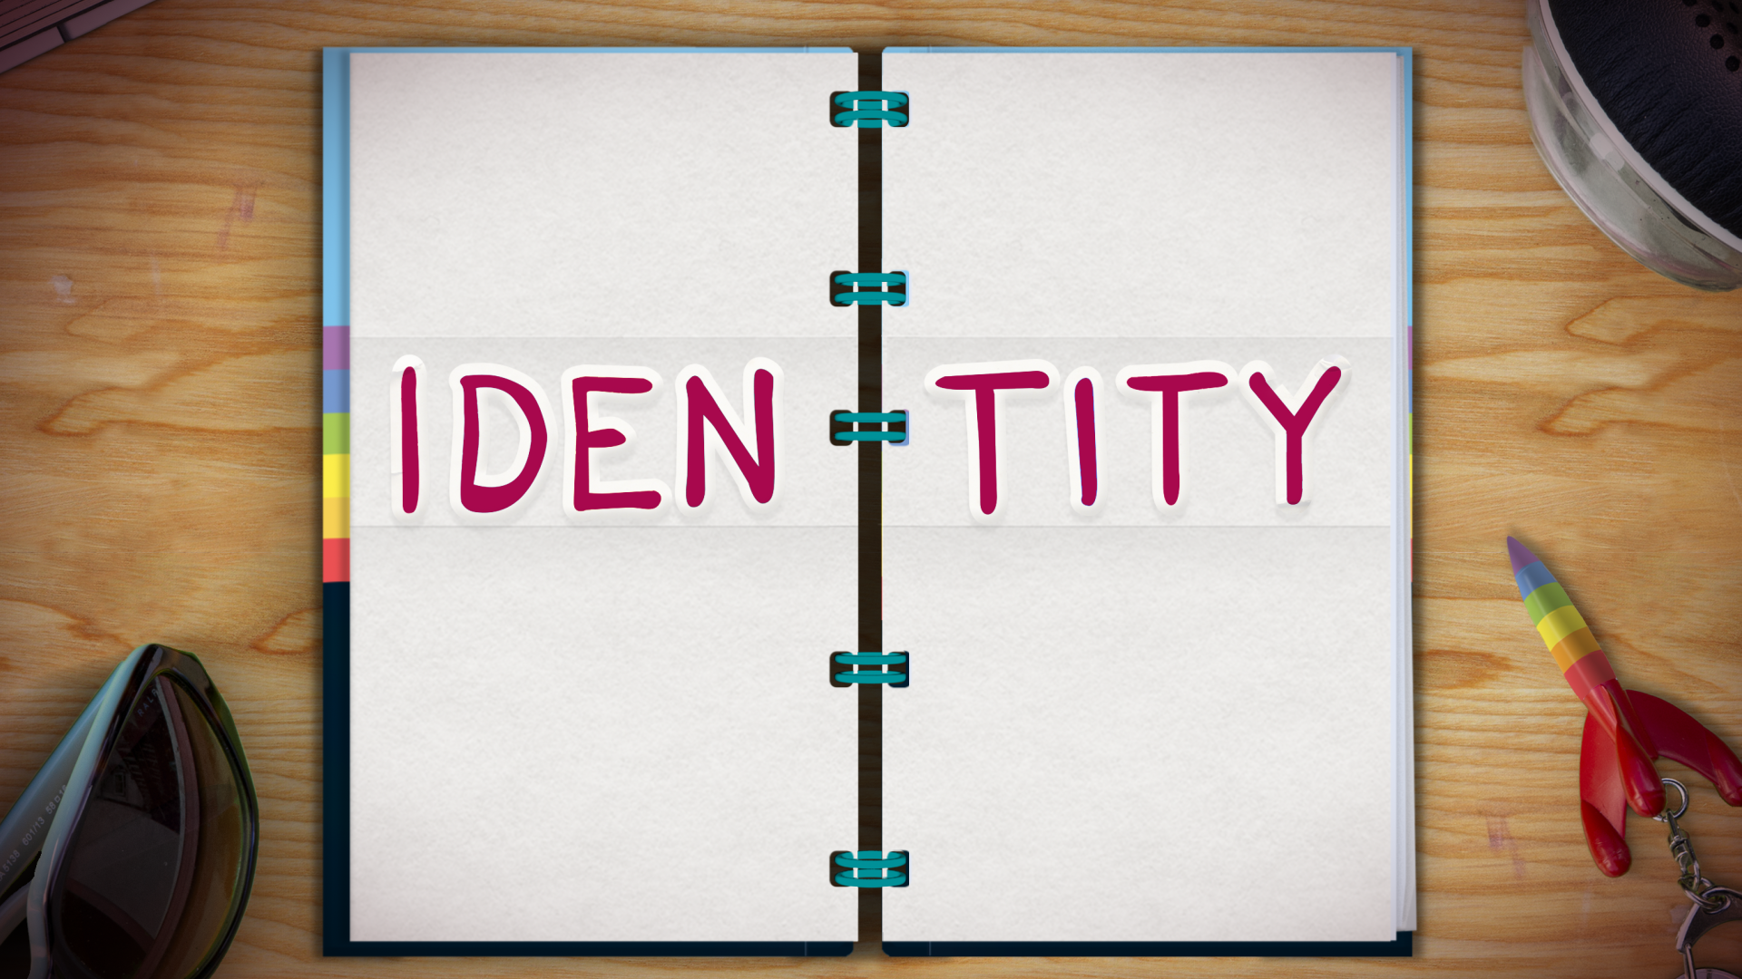
Identity means who we are, how we feel and how the world sees us.
One part of our identity is our “gender identity”.
Notes:
Discussion points:
Open up discussion about what identity is:
It is who you are, how you feel about yourself, how the world sees you.
It can include things like your culture, your nationality, your religion, your age…
Your identity is not always something that can be ‘seen’.
It also includes things like your gender and your sexuality. These are an important part of who you are. You cannot tell someone's gender identity or sexuality just by looking at the person. Everyone is different and unique. We are all individuals.
Activity idea: if it would be helpful to fill out an example as you work through these slides, check out the gender unicorn template here: https://transstudent.org/gender/
You can use the 'gender identity' part of the template for these slides.

Slide 7
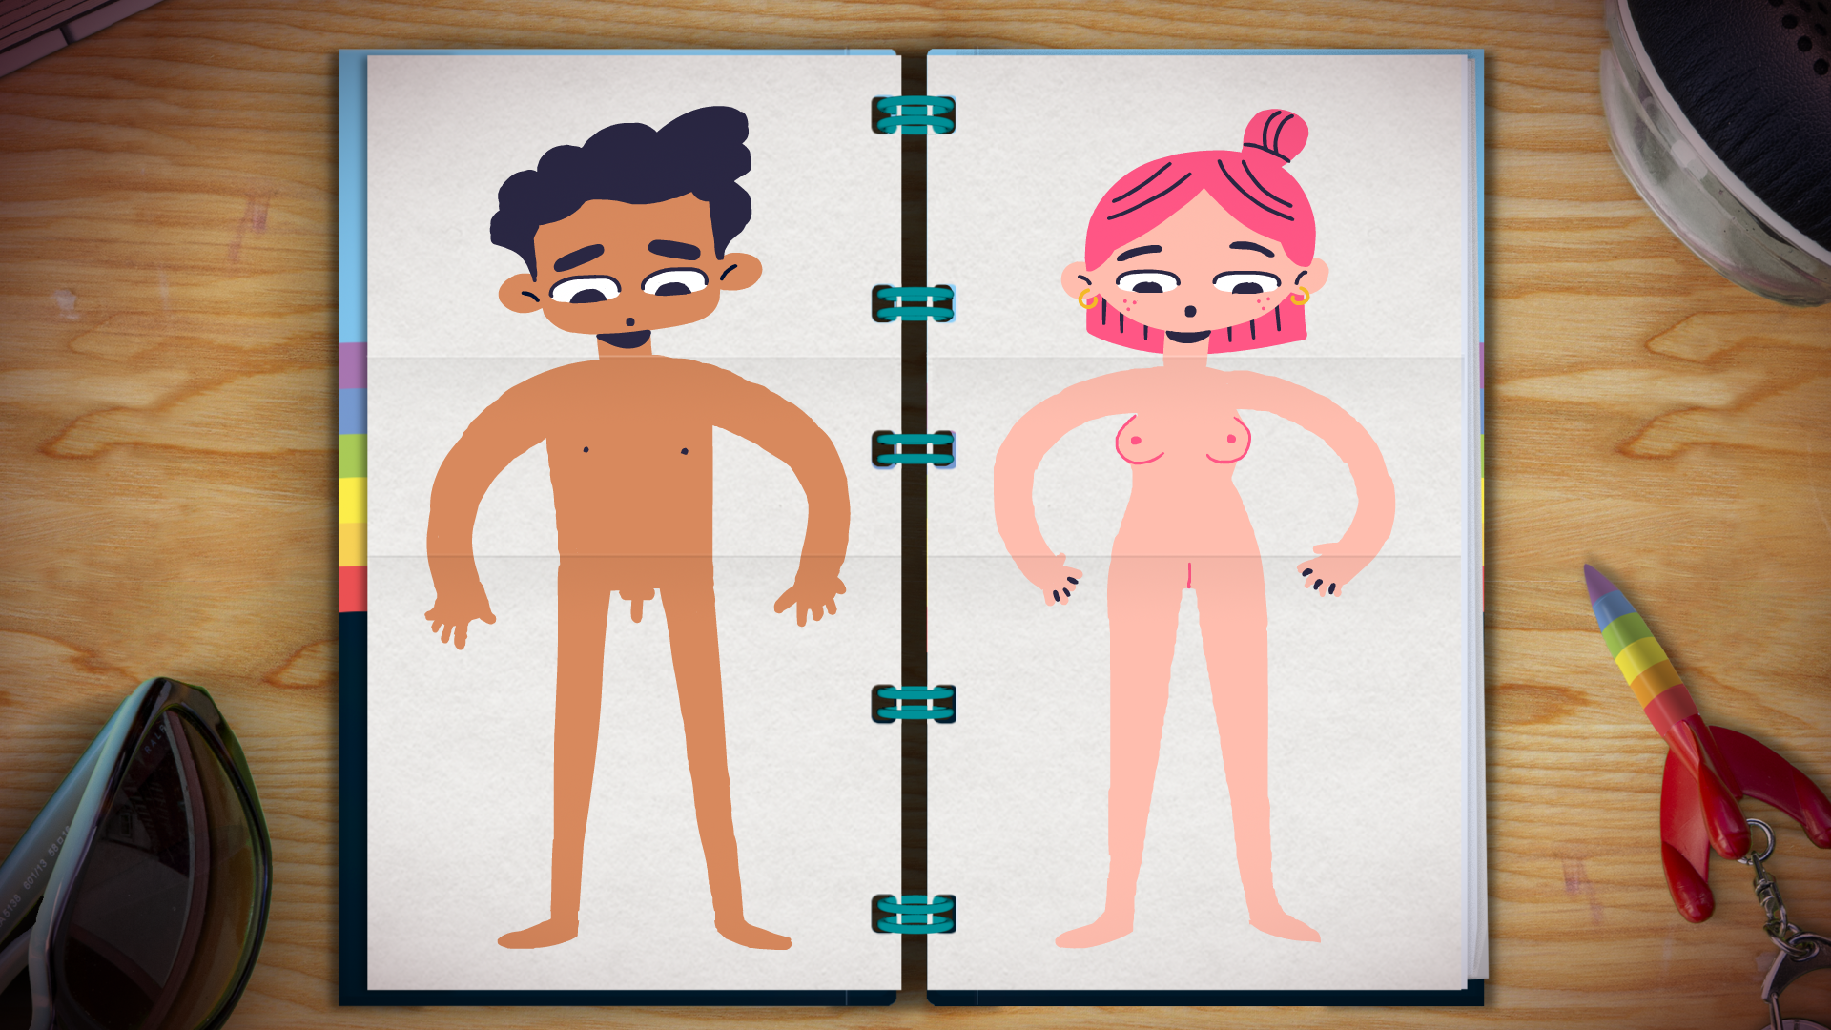
Our gender identity can be linked to our private body parts that we are born with.
But it does not have to be.
What’s most important is how you feel inside.
Notes:
For this slide it is important to explore ‘sex assigned at birth’. When a baby is born their gender identity is decided based on the sex associated with ‘male or female’ reproductive organs. To explain this, you need to ensure that you first discuss and name these body parts using the correct anatomical names.
Brook have body part images you can use, in the 'body parts' section of their sexual expression toolkit. https://legacy.brook.org.uk/attachments/Sexual_Expression_Resource.pdf
Once this concept has been better understood you can open a conversation about body parts and gender.
While some people will feel comfortable with their gender being matched to those body parts, not everyone will. For some people this can feel very upsetting because they know their gender identity is different to what they have been told.
Activity idea- using the Gender Unicorn template you can discuss how someone might identify (the same as their sex assigned at birth or not) https://transstudent.org/gender/
Use the Brook images to explain body parts and teach the correct terms https://legacy.brook.org.uk/attachments/Sexual_Expression_Resource.pdf

Slide 8
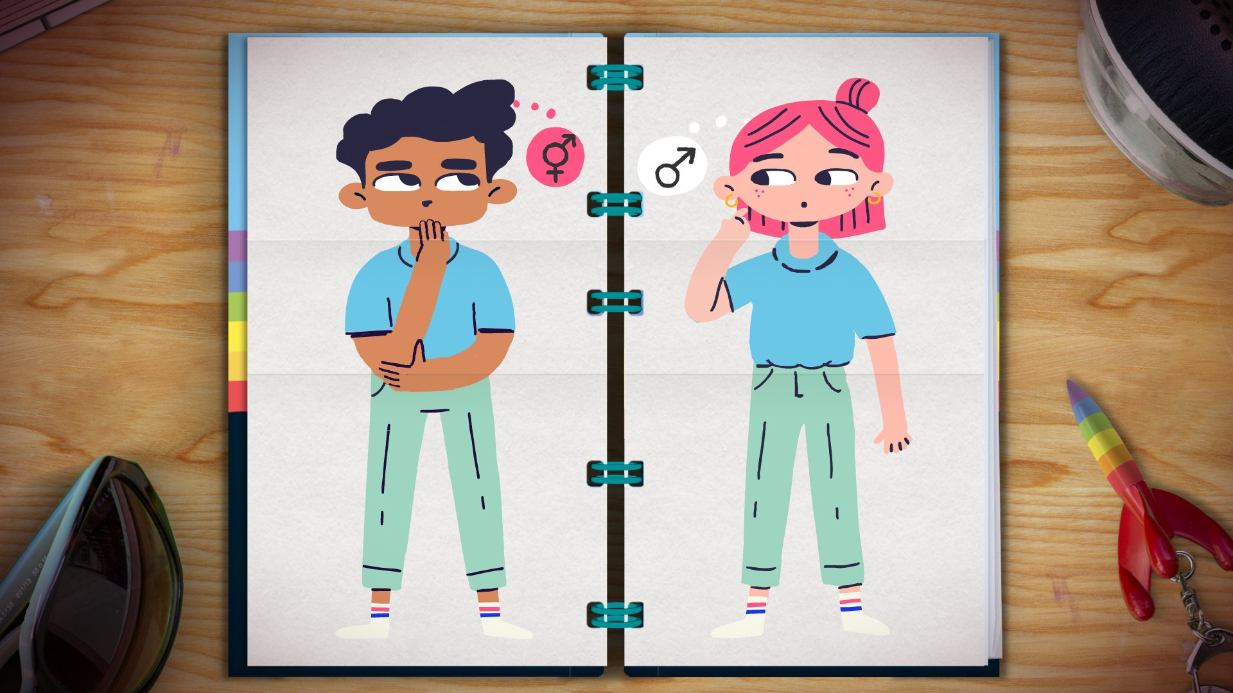
We can identify in lots of different ways!
We are all individuals.
Only you can decide how you identify
Notes:
This is a good time to discuss that everyone is individual and unique. No two people are the same. There are a lot of different ways we can feel about who we are.

Slide 9
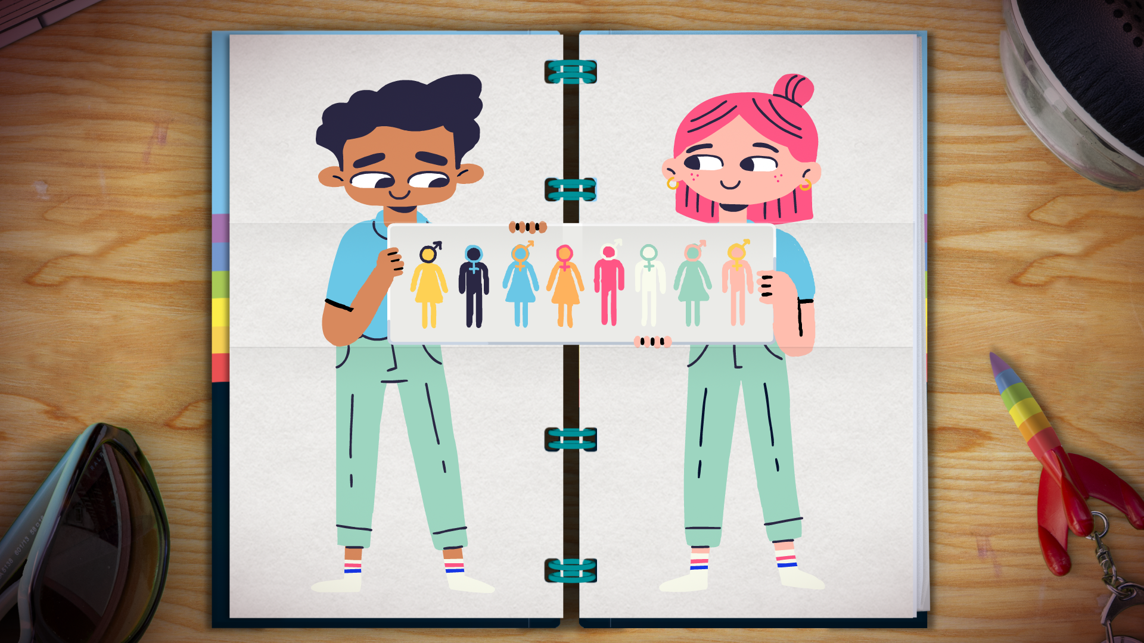
Notes:
For Easy Read information on LGBTQ+ identities please see the following resources to help guide your conversation. You can use the Easy Read information to explain how sexuality and gender are on a spectrum.
https://www.changepeople.org/our-work/lgbtq-an-easy-read-guide
https://www.choicesupport.org.uk/uploads/documents/Transgender-easy-read-guide-For-Web.pdf
Activity idea: Everyone is unique and an individual. Use this 'You Being You' worksheet to look at the ways in which everyone is unique and how great it is that no two people are the same. https://www.twinkl.ie/resource/celebrate-being-you-worksheet-t-p-994 (available for free download) If you are doing this with a group you can ask people to share responses if they are comfortable, perhaps creating a collage of answers that celebrate individuality. This can be referred to throughout this presentation and when discussing the animation.
The Gender Unicorn resource will also be helpful here. https://transstudent.org/gender/

Slide 10
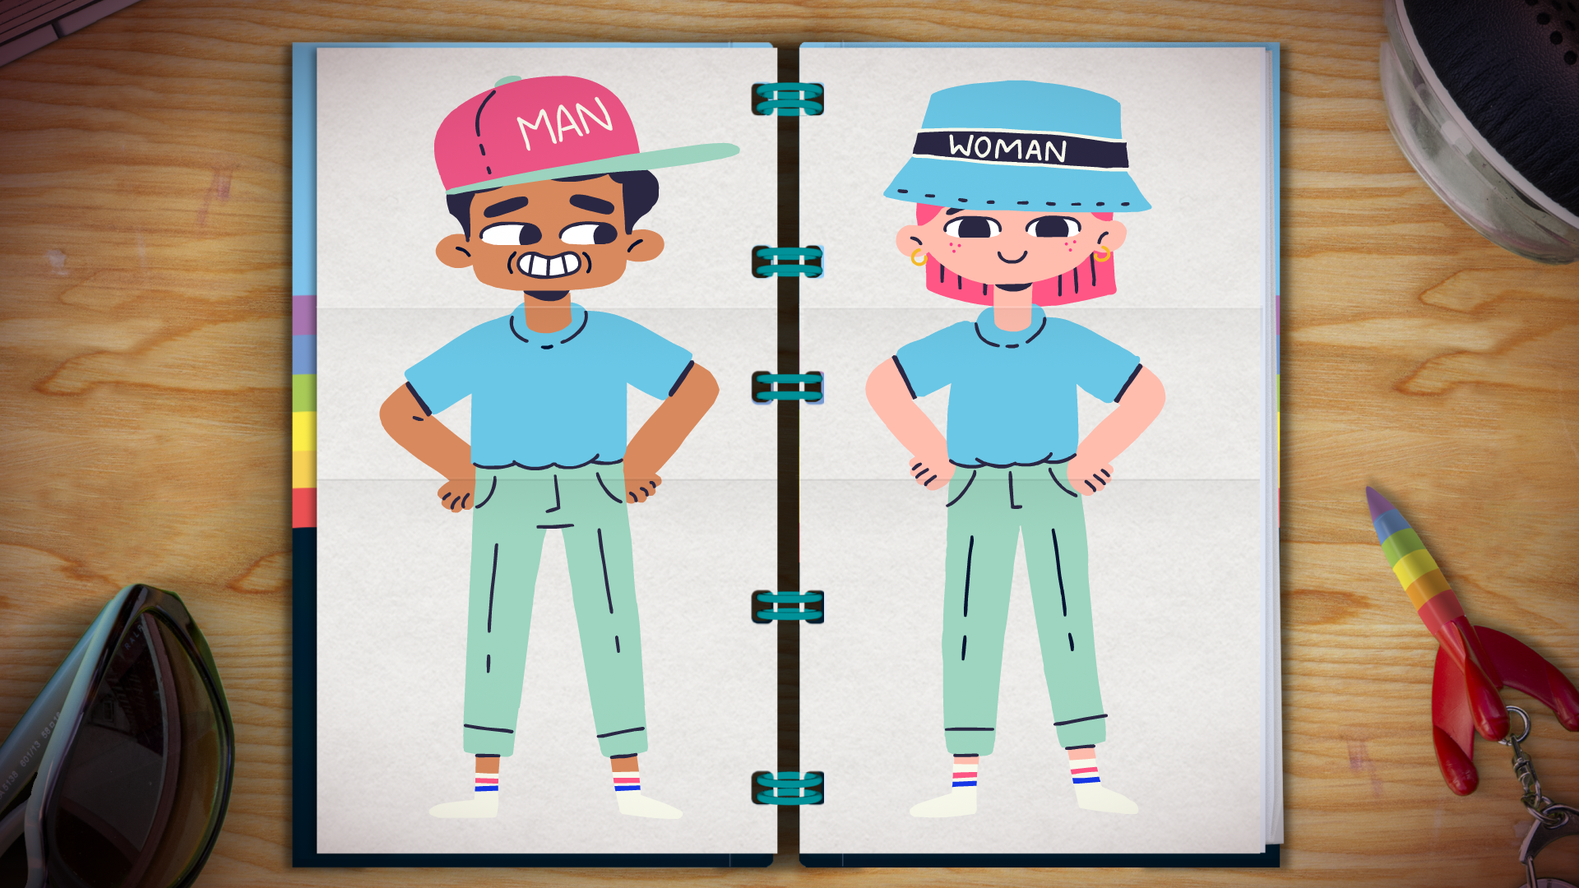
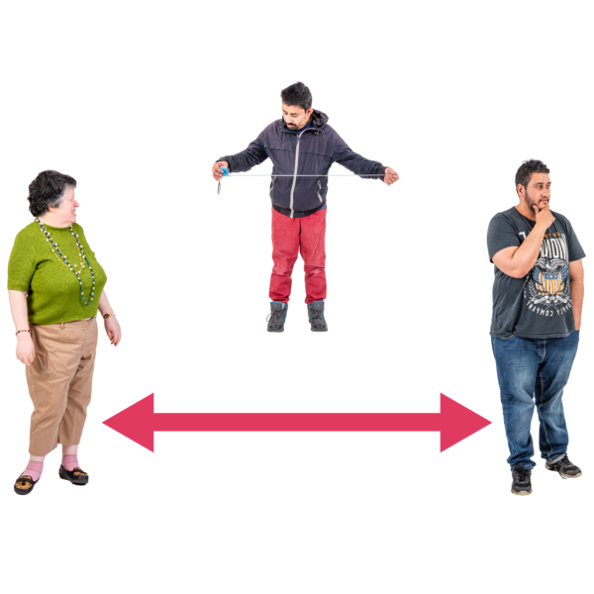
Words like these help us describe how we feel.
Male, female, both, neither, or somewhere in between.
Notes:
Activity idea:
Using a visual to highlight the spectrum of gender, the people you are working with may want to discuss how this relates for celebrities or people that they recognise (for example celebrities who are non-binary like Sam Smith or Jonathan Van Ness). Use celebrities or public figures who are relevant to the group you are working with and their interests. It is helpful if you choose examples of people who are relatable to who you are working with.

Slide 11
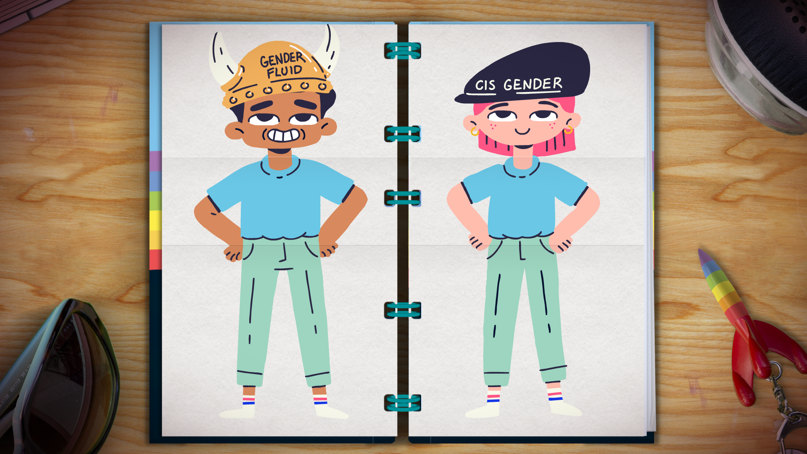
Notes:
Using the Easy Read guides, discuss how some people can feel differently and where they fall on the spectrum can change. People who feel like this might identify as gender fluid. It is okay to not feel sure of your identity. It is okay if how you identify changes.
Activity idea: Use Gender unicorn template to illustrate the spectrum https://transstudent.org/gender/

Slide 12
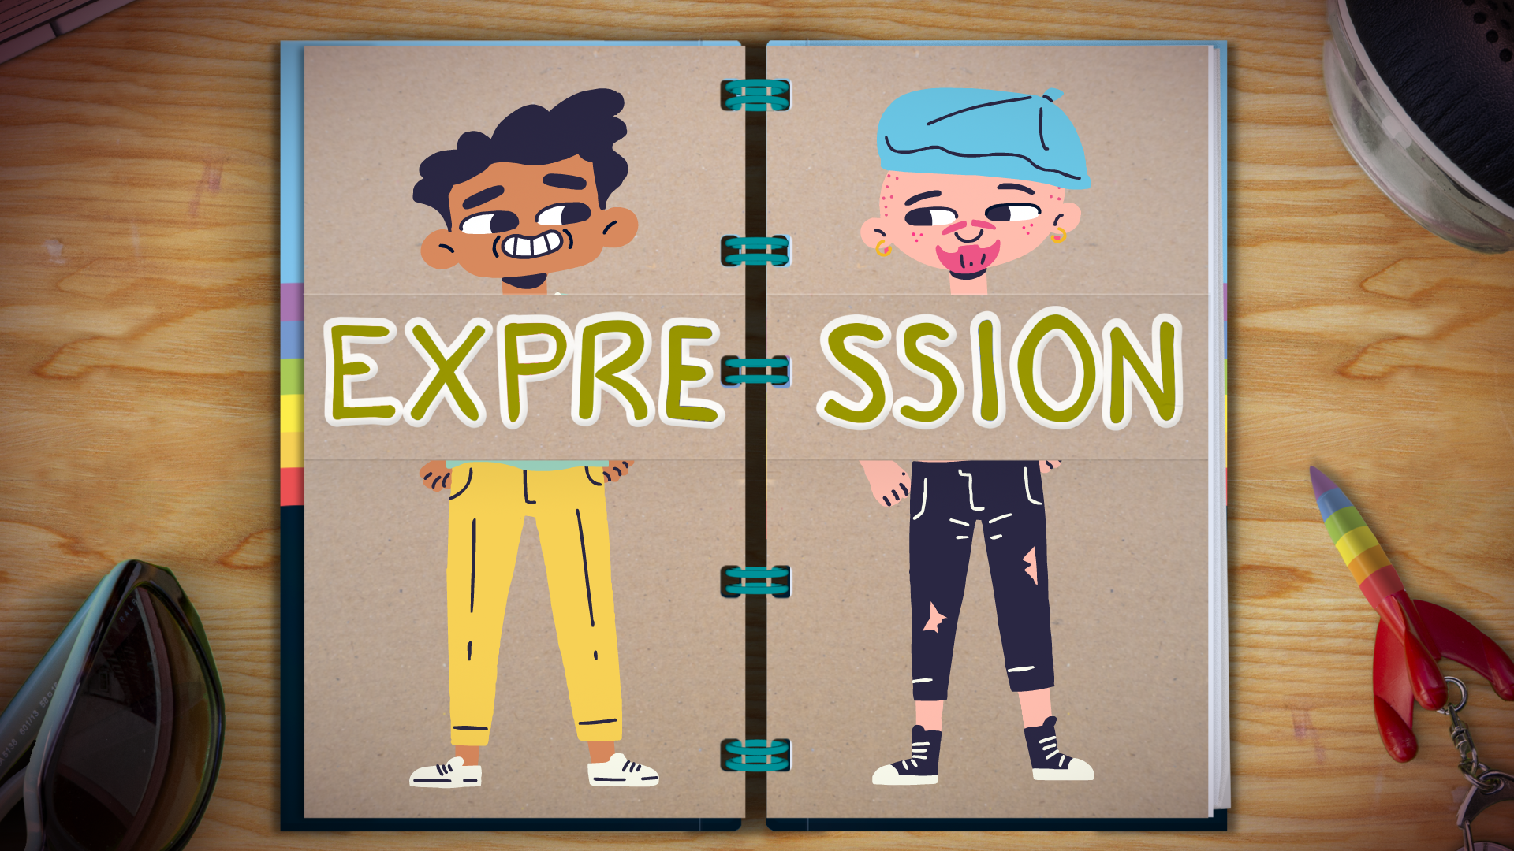
“Gender expression” is how we show our gender to the world.
It's how we dress, how we behave, and how we want our bodies to look.
Notes:
Gender Expression: ’The physical manifestation of one’s gender identity through clothing, hairstyle, voice, body shape, etc. Most transgender people seek to make their gender expression (how they look) match their gender identity (who they are), rather than their sex assigned at birth.' https://transstudent.org/gender/

Slide 13
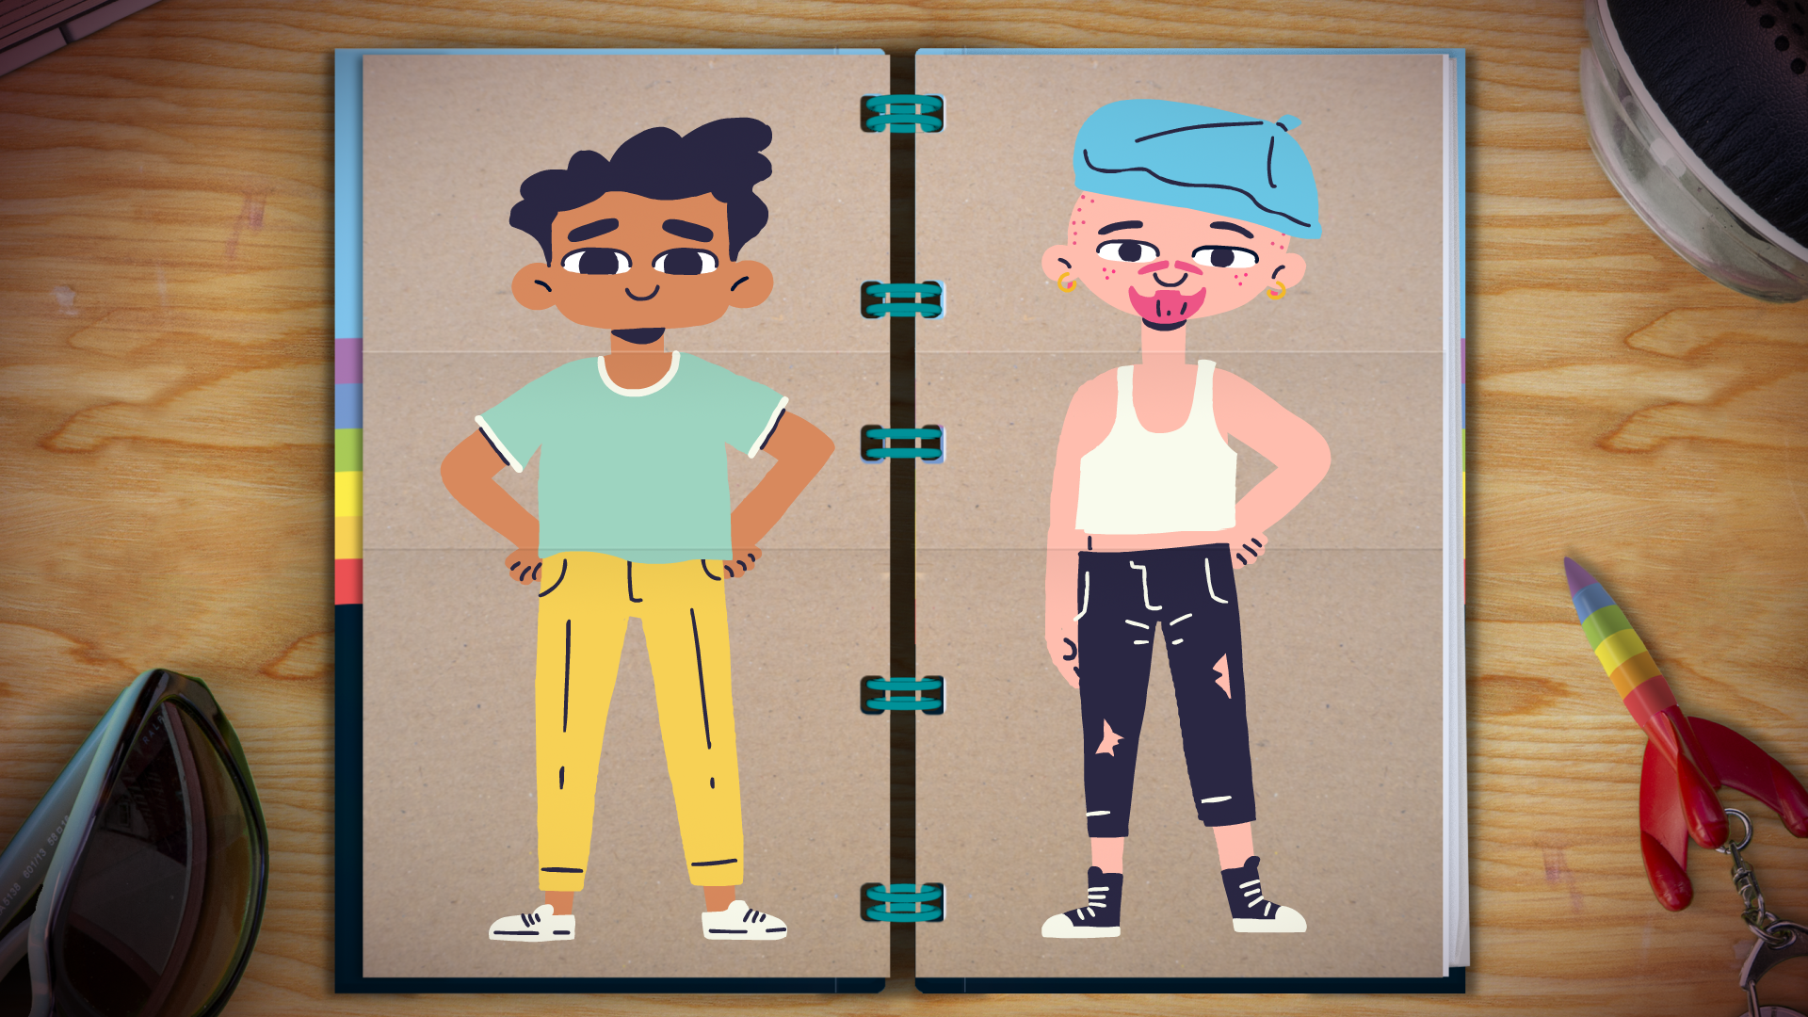
We can express ourselves and our gender.
We can do this through our clothes, make up, hair, our style and how we show ourselves to the world.
Notes:
Activity idea:
You can open up this conversation by asking how people like to express themselves generally (through music, sport, being with friends, their clothes, their hair etc). Ask how can people express who they are to someone else? How do they do this?
You could also suggest looking up their interests online and printing pictures of things that help express who they are (make a mood board of these images). Ig in a group you can ask if they want to share, this way you will see how the images can be different for each person. This shows how we all express ourselves differently.
Discussion points:
People can also express their gender to others too. We sometimes guess a person's gender by the way they look. But not everyone is comfortable expressing their gender identity.
For trans and non binary people one way which they can show their gender to others is by starting to dress and behave in the way that matches their gender identity. (You can think of celebrities that express their gender through clothes and appearance like Sam Smith and Jonathan Van Ness who are both non binary)

Slide 14
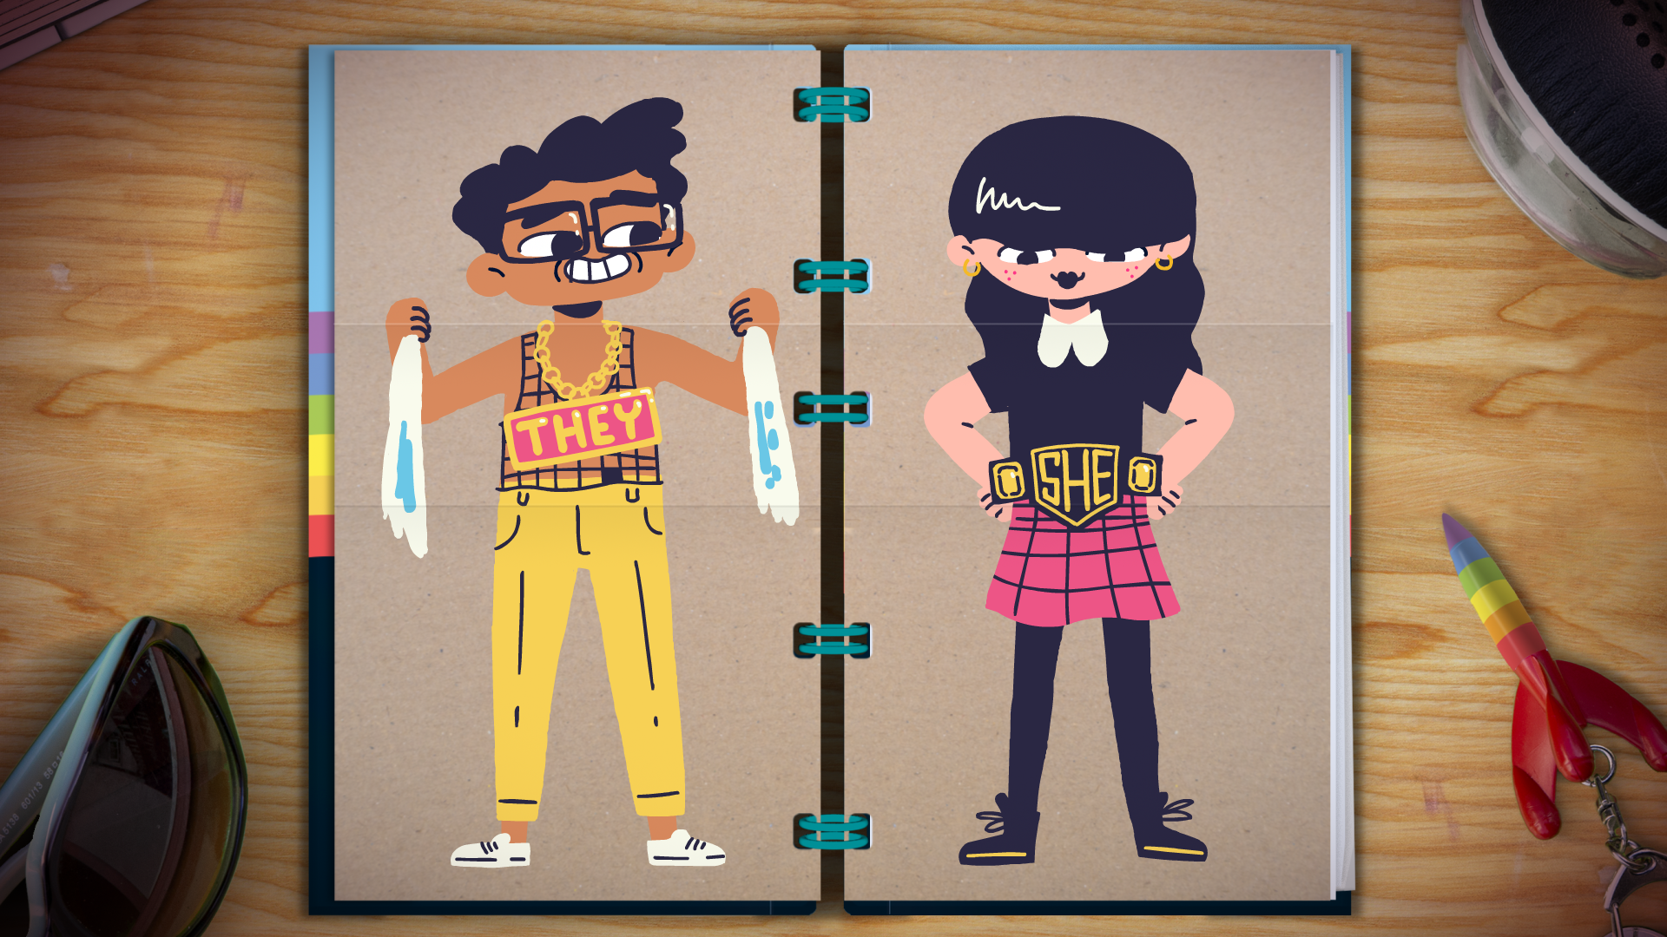
This also includes the words we want people to use-
words like ‘he’, ‘she’ or ‘they’, and our name.”
It’s your right to say who you are and how you want to express that!
Notes:
Pronouns are words like 'he, she or they'
Sometimes we guess a person's pronouns by looking at them. But we should always check what pronouns a person uses.
Discussion points: Only you can decide how you feel and who you are. There are people who can help trans and non binary people to better understand how they feel. (For more information on transition see https://www.choicesupport.org.uk/uploads/documents/Transgender-easy-read-guide-For-Web.pdf
For trans and non binary people their pronouns can be different to the ones they had when they were born. They might also change their name. It is very important to call someone by the right name and use the right pronoun. You should ask someone what pronouns they use and not assume.

Slide 15
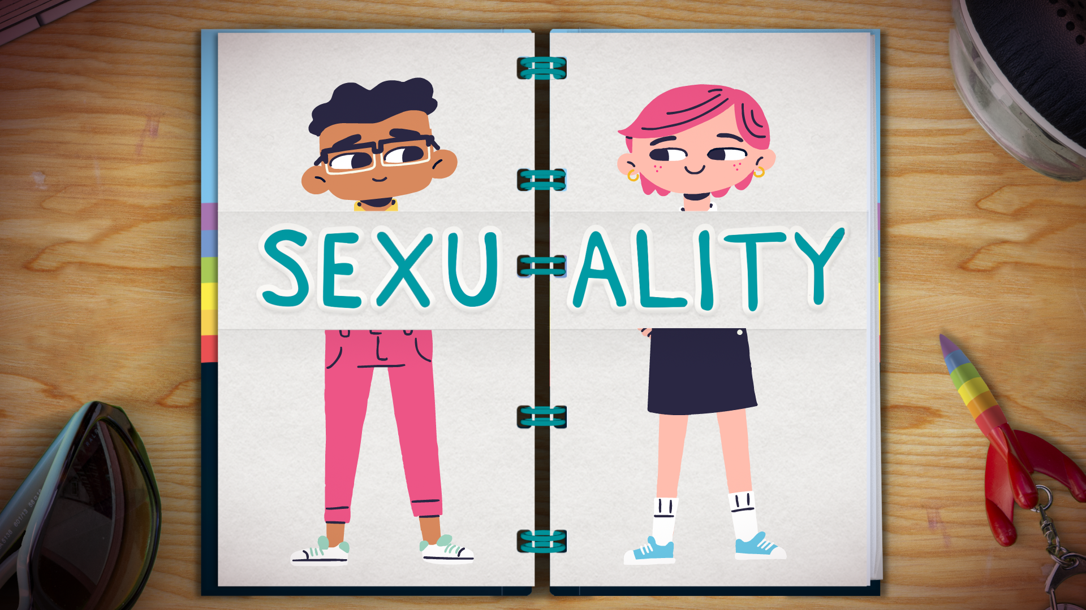
Notes:
Everyone has the right to understand their sexuality and be themselves.
Sexuality is how you feel about:
yourself
your own body
other people

Slide 16
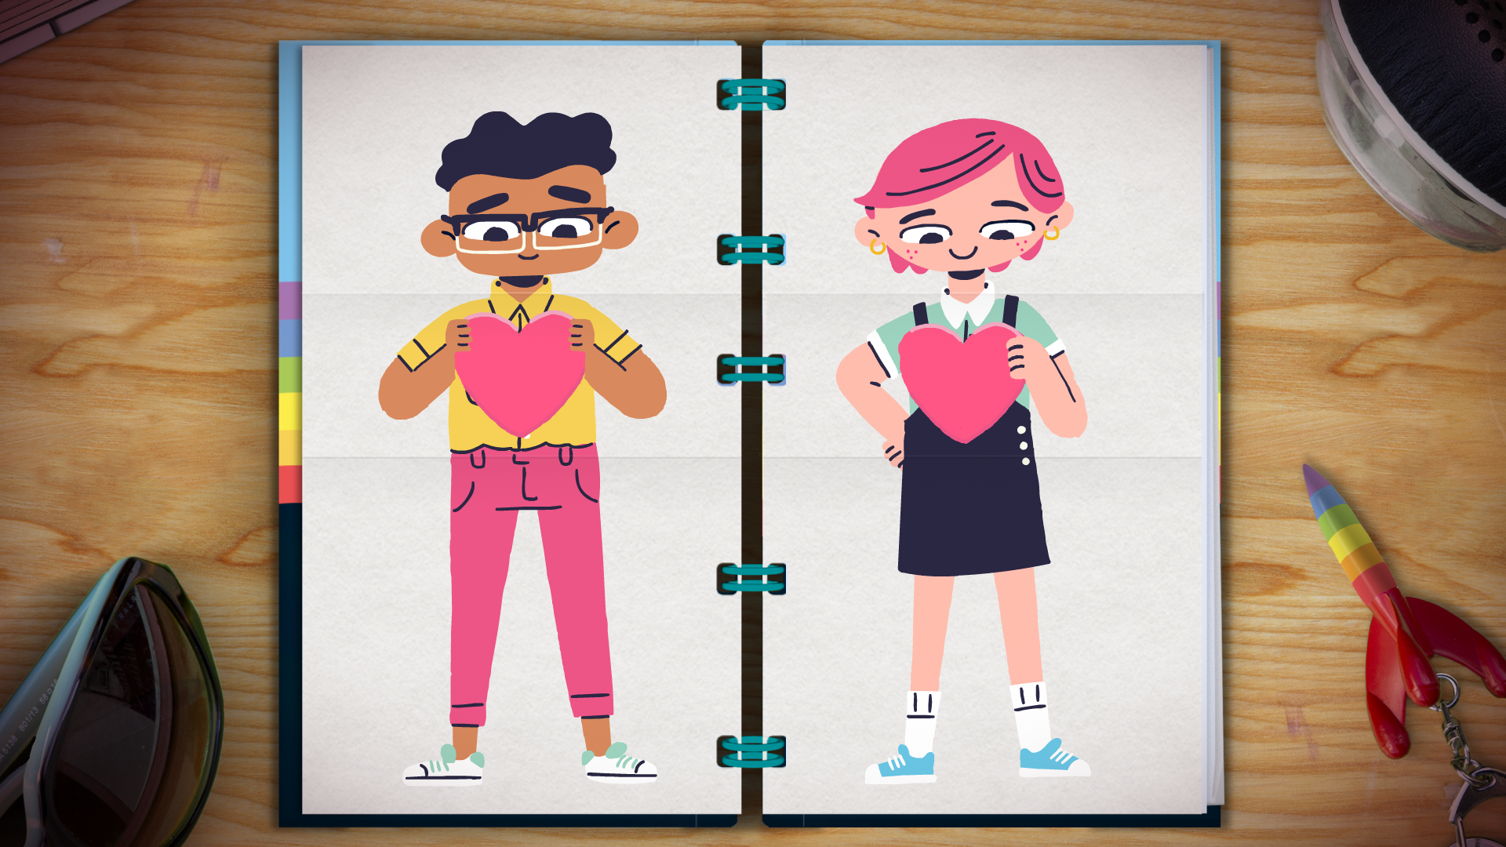
Your ‘Sexual Orientation’ is another really important part of who you are.
It means who you are attracted to.
Notes:
Discussion points: Our gender is a very important part of our identity.
Just like gender, there are a lot of different ways we can identify with our sexuality
This is also on a spectrum.
For Easy Read explanations see https://www.changepeople.org/Change/media/Change-Media-Library/Project%20Media/LGBTQ-booklet-SCREEN-READER-18-05-20.pdf

Slide 17
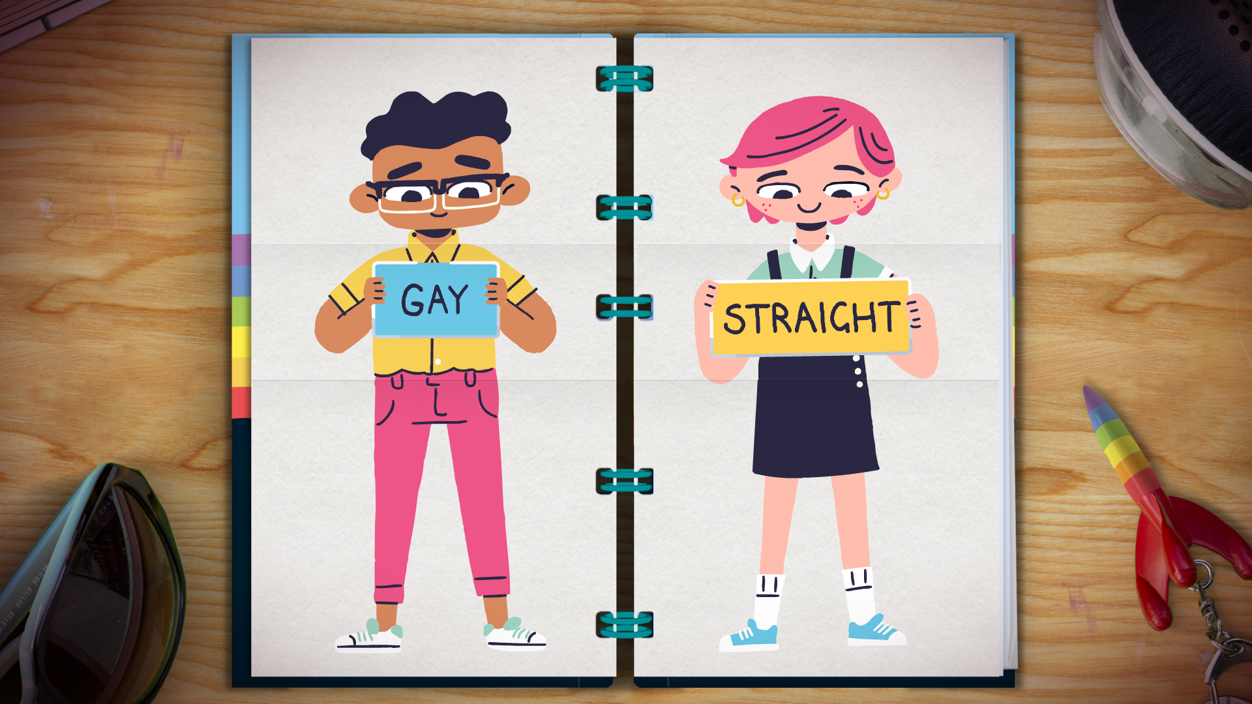
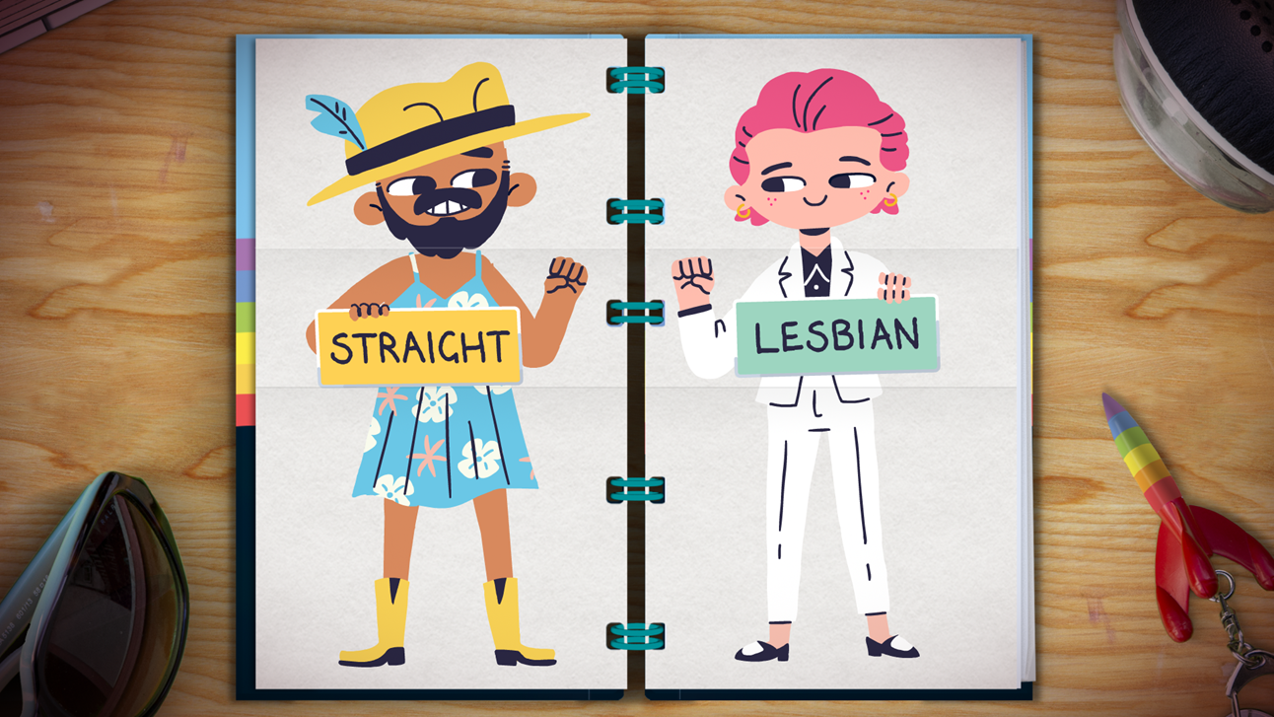
Your sexual orientation might be connected to your gender identity and gender expression, or it might not!
Notes:
Discussion points: Sexuality and gender are two different parts of you. How you identify and who you are attracted to are different things.
Activity idea: The Gender Unicorn template can be used to illustrate the sexuality spectrum and how it differs from gender. https://transstudent.org/gender/

Slide 18
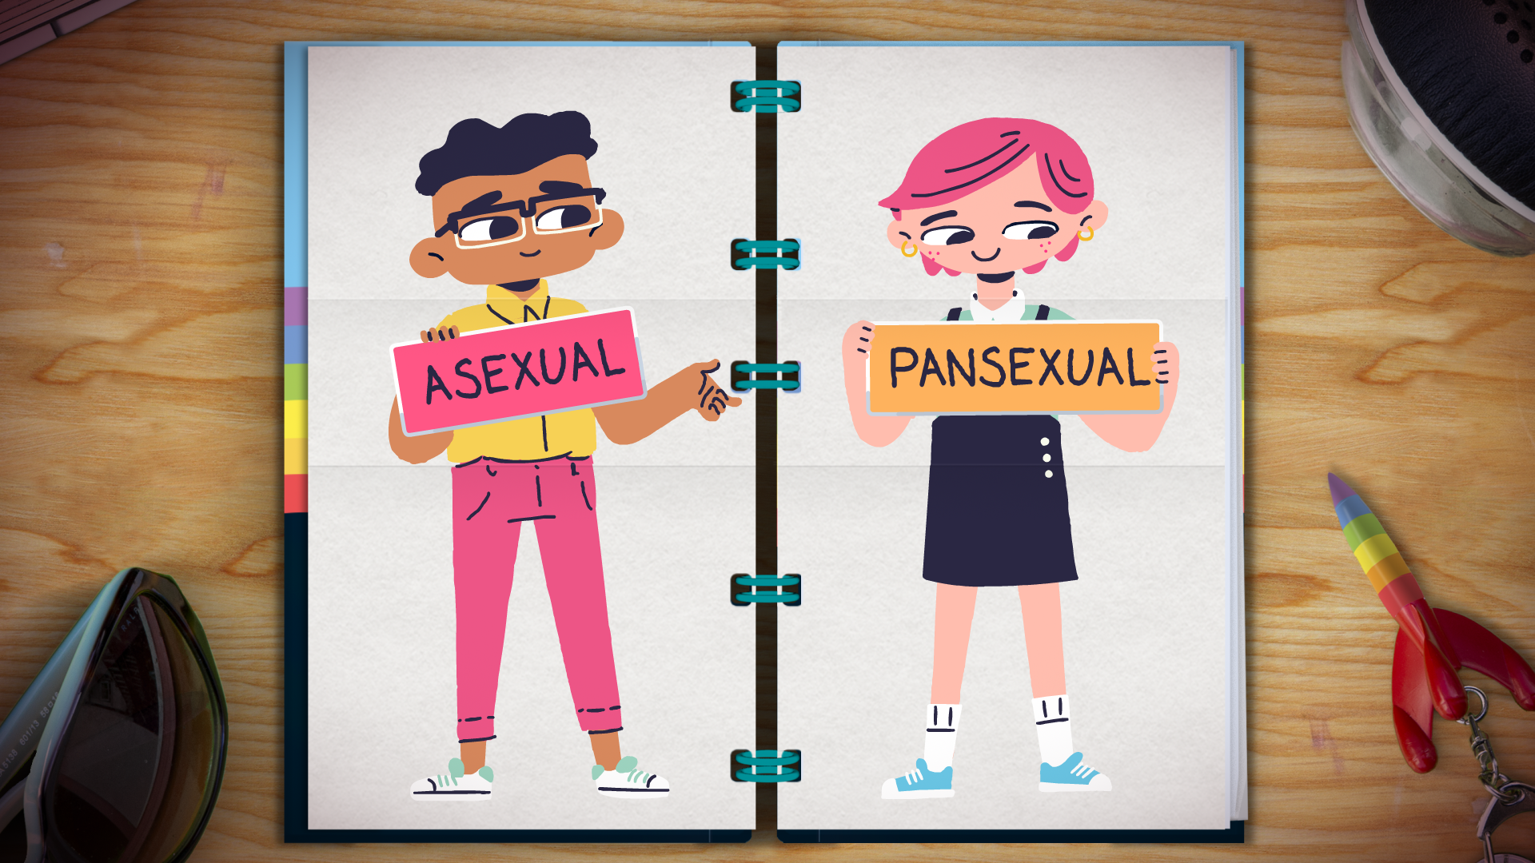
Like your gender identity, there are lots of ways you can identify with your sexuality too.
Notes:
You can use the Gender Unicorn template to illustrate how sexuality is also on a spectrum, and a different spectrum to gender https://transstudent.org/gender/
Some people do not want to 'label' their sexuality at all, and this is okay too!

Slide 19
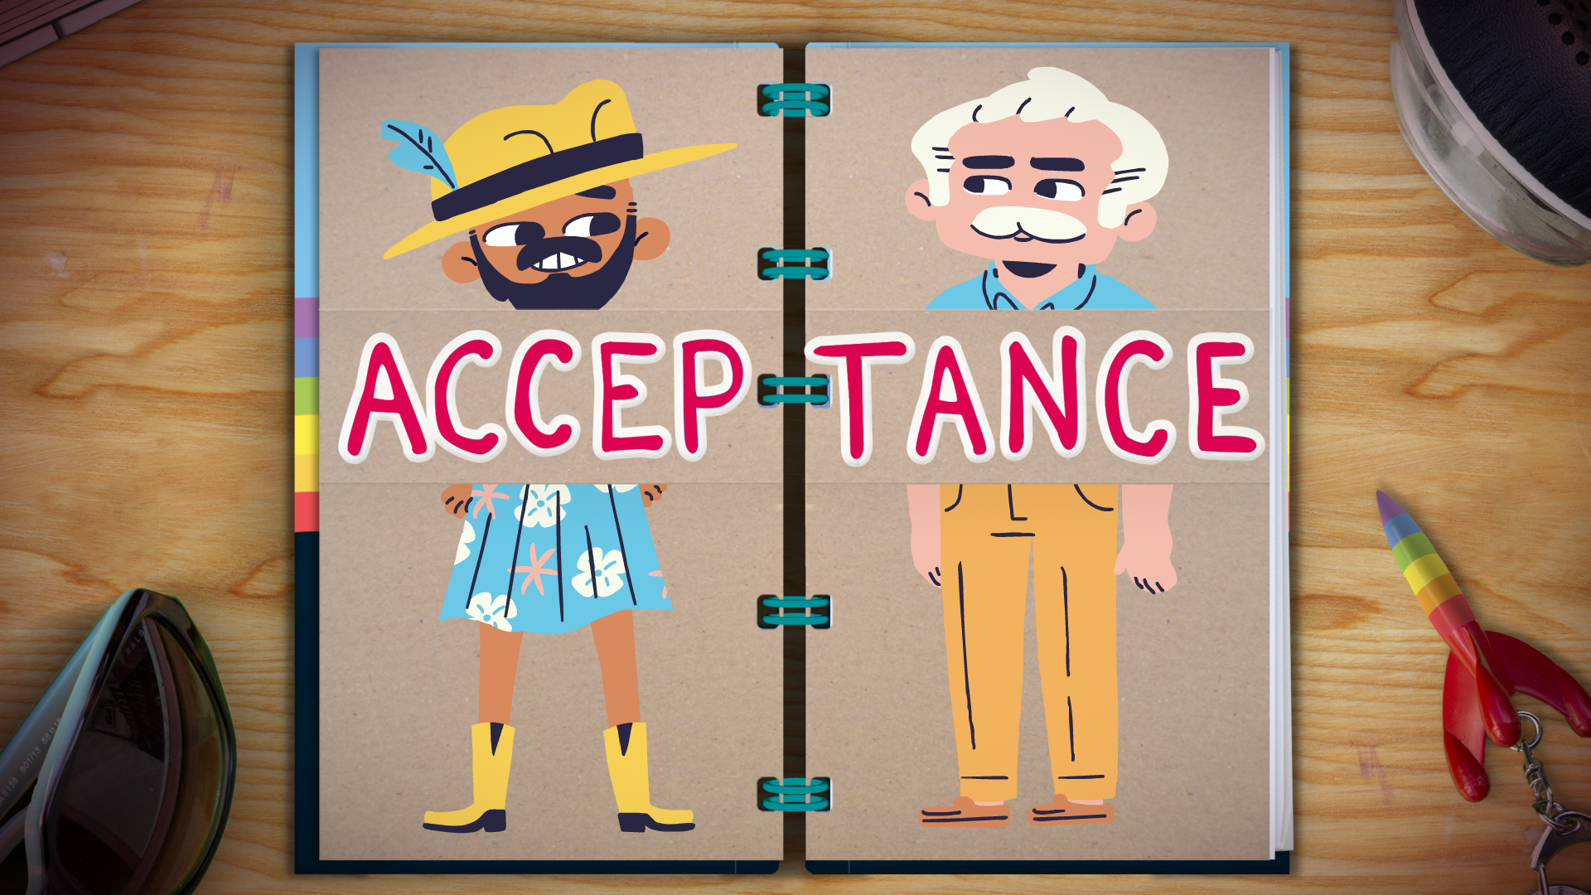

Slide 20
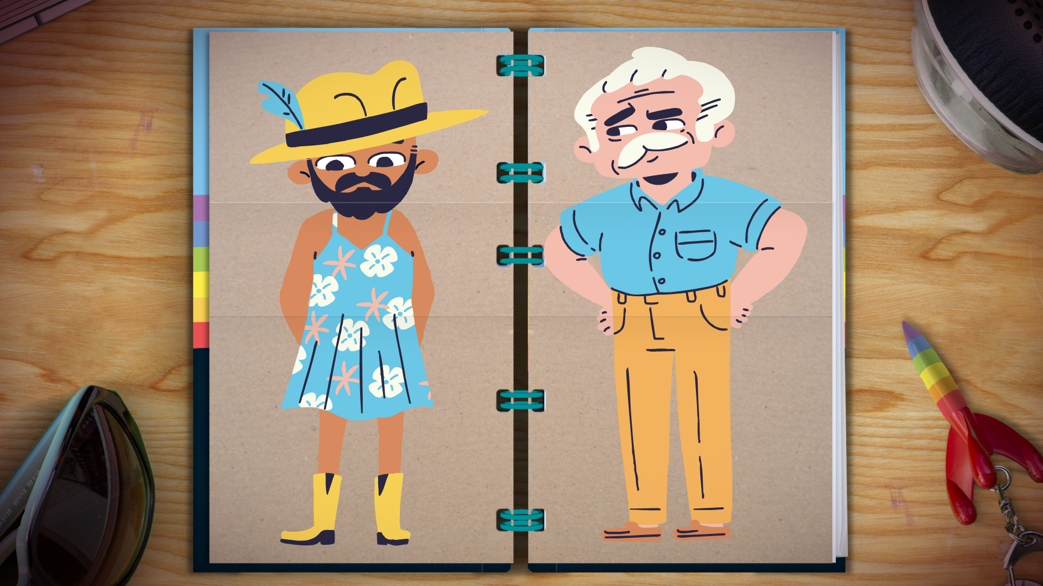
Sometimes people in our lives don't know or understand how we feel about our gender and sexuality.
So, they don't see the whole picture of who we are.
Notes:
Discussion points: Ask how do you think this person feels that someone is judging them for just being themselves? What advice can you give?
Why do you think it can be hard for someone to open up about their gender or sexuality? What can help?
Sometimes people just don't have enough information to understand about sexuality and gender. This can make it hard for them to know how to help. But there is advice and support available. (See Stonewall and Gendered Intelligence for advice and training information for professionals)

Slide 21
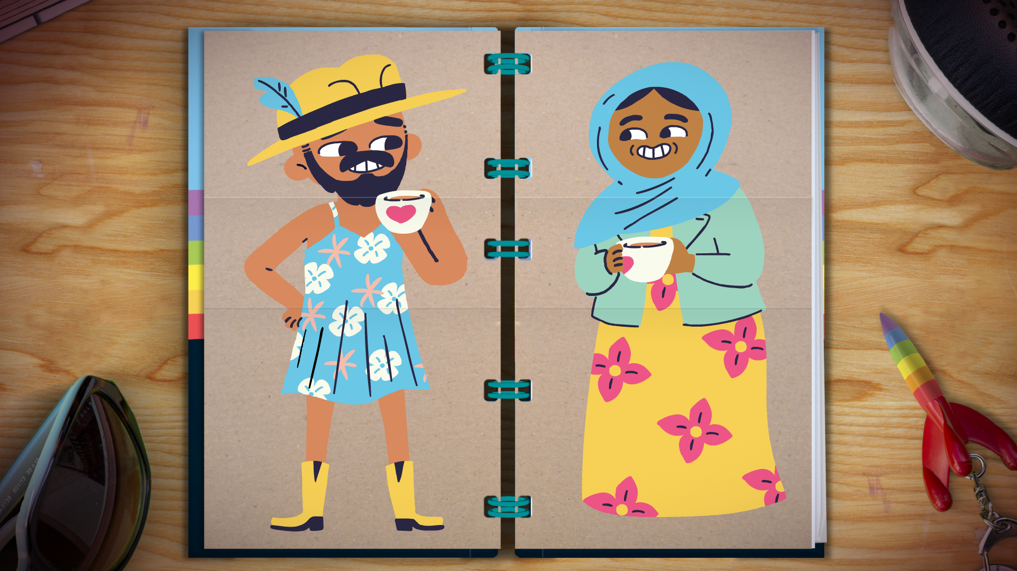
It’s good to talk to someone you trust about how you feel, if you want to.
It might help you understand yourself better too.
Notes:
Discussion points: Now this person is getting good support from someone is being kind and listening to them.
How can you be a good supporter to someone? What does a good supporter do? Why is it important to never judge someone’s sexuality or their gender? (explain that this would be discrimination and it is wrong to discriminate against a person’s sexuality and gender, this is against the law)
Activity idea: You can explore acceptance and look at what makes a good friend or a bad friend.
Develop this further by listing the ways you can be a supportive friend (or ally) to someone who is LGBTQ+ (use the list of those ‘good’ qualities that make a good friend. Explain that the relationship between friends should not change regardless of a friend's gender or sexuality). For example if someone likes a different football team or a different music artist to you it should not stop you from being friends. People can identify differently to you and it should not stop you from being friends.

Slide 22
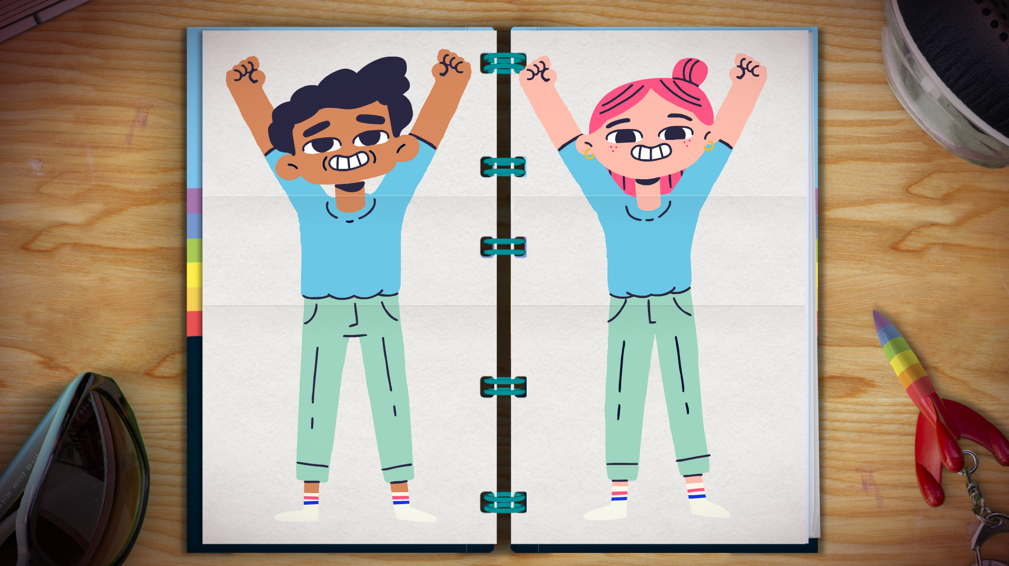
It’s a good thing to understand who you are and how you feel.
Let’s celebrate YOU BEING YOU!
Notes:
It is a wonderful thing to be yourself! You should celebrate being you!
There is a special time each year where LGBTQ+ can celebrate and the people that love and support them celebrate too! This is called Pride
You could design a poster for Pride month or get involved with local LGBTQ+ support groups and join in their celebrations.

Slide 23
Resources
Stonewall
Gendered Intelligence
Gender Unicorn
Easy Read Stonewall LGBT
Easy Read LGBTQ+ booklet
Easy Read Trans guide
Notes:
There are lots of places to get more advice, information and support. It is okay not to have all the answers. There are places which specialise in LGBTQ+ information and support. There are also a lot of online support groups and forums for LGBT people, their families and supporters. Supported Loving have a list of LGBTQ+ support groups for people with a learning disability on their website. https://www.choicesupport.org.uk/about-us/what-we-do/supported-loving/supported-loving-toolkit/lgbtq-social-groups

